Slide 1
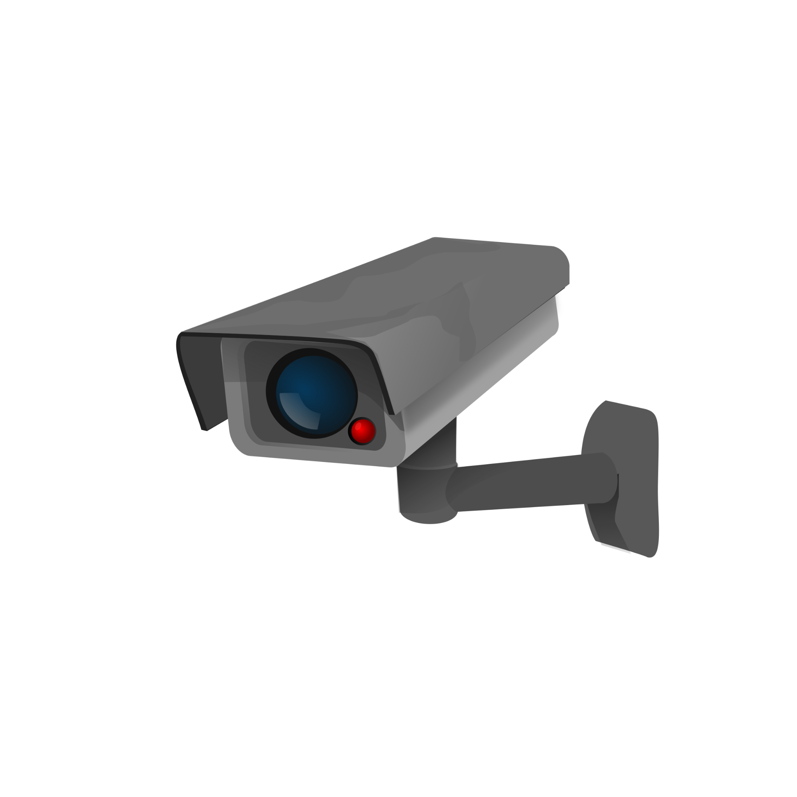

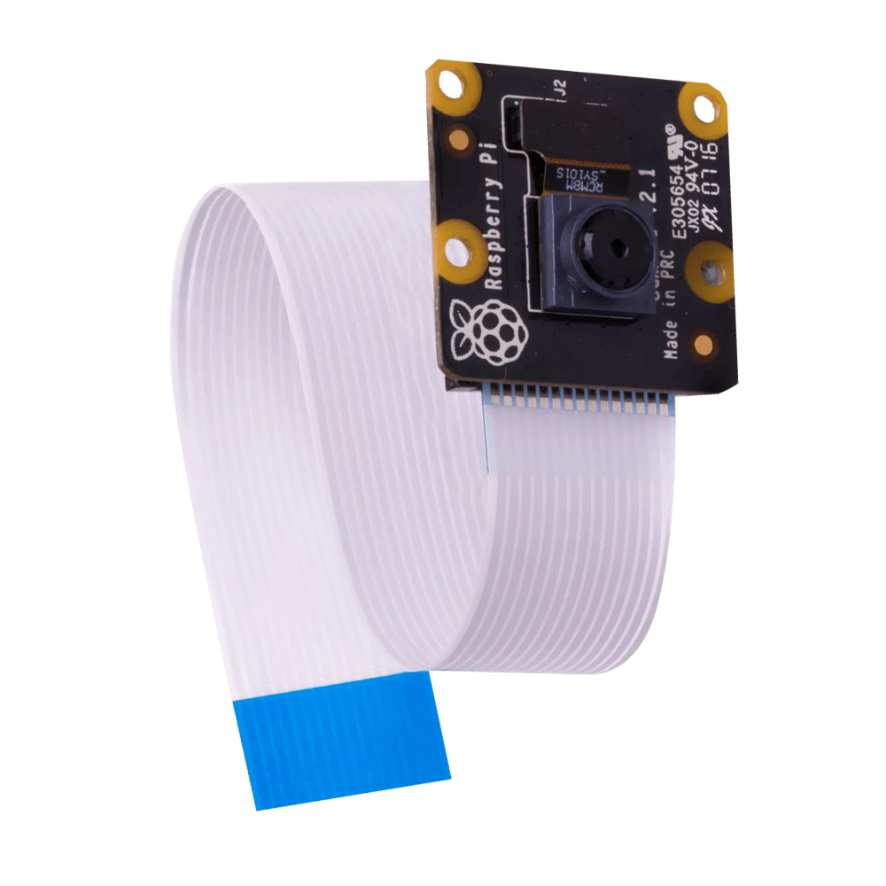
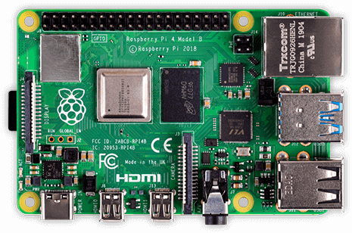


Visitor-Counter
Stefan Düx | Jessica Isabella Görög | Dominic Grabner | Rebekka Tscheppen | Lukas Varga
Visitor-Counter | Group 29 | BIF4 | Innovation Lab 2 | “the Observer”

Slide 2
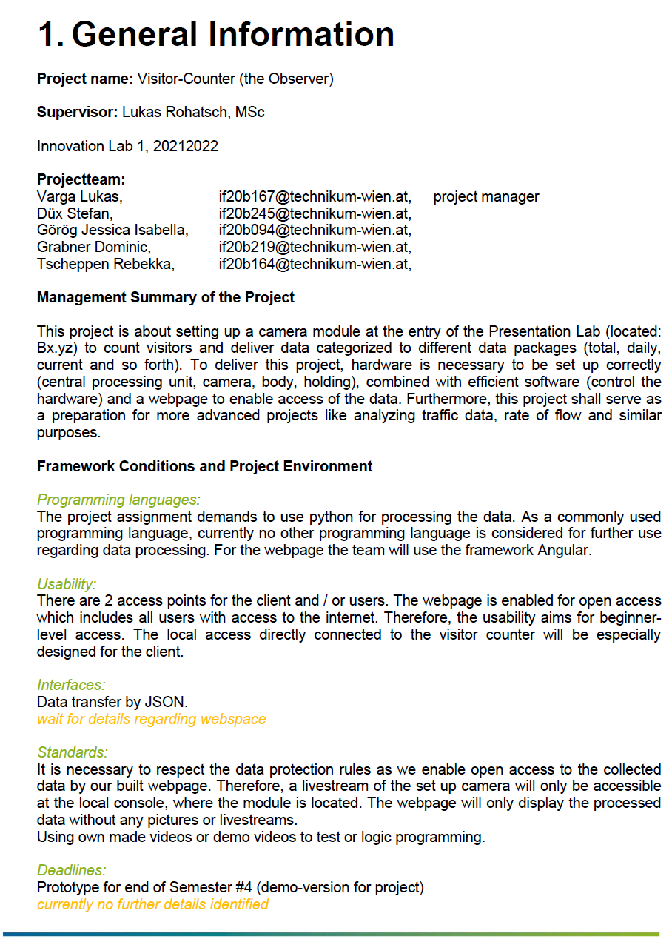
Description
data recording + analysis via raspberry pi 4 + camera module
person recognition to count visitors at Presentation Lab (FH Technikum)
adapted with interface, web-application and further data processing

Slide 3
Status Quo
Autostart
Logic (class based / multiprocessing)
Interface
Mqtt
Open steps

Slide 4

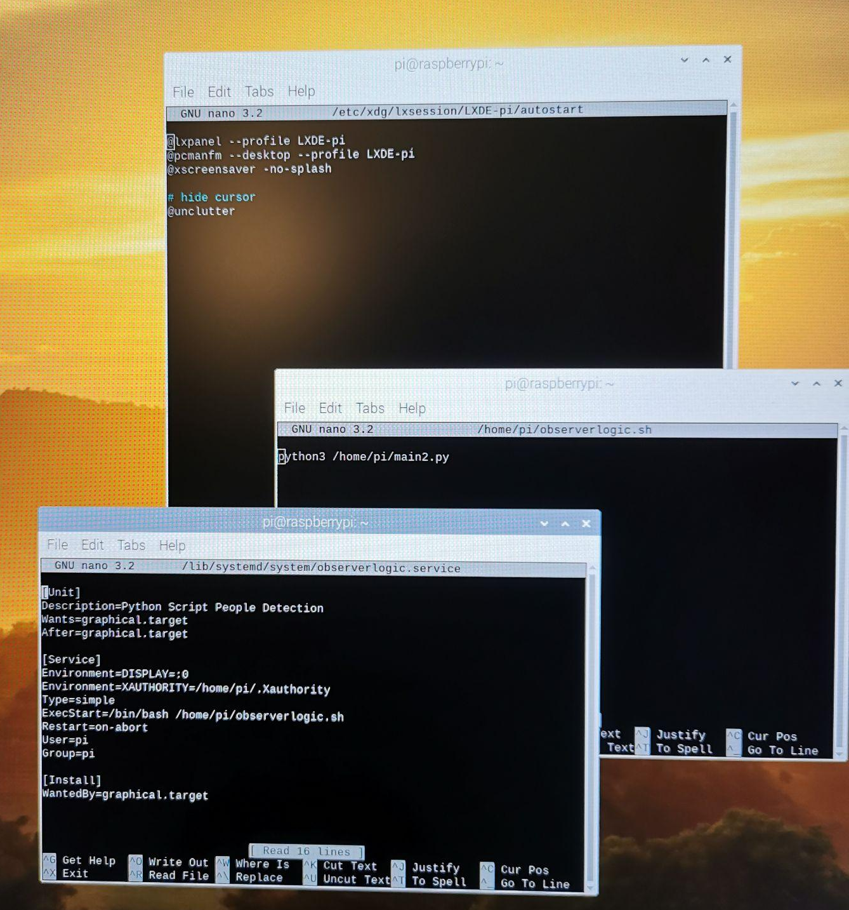
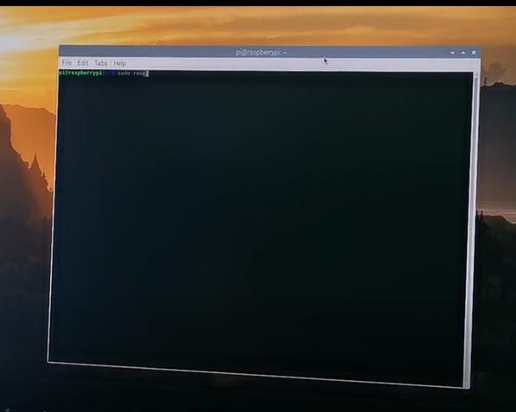
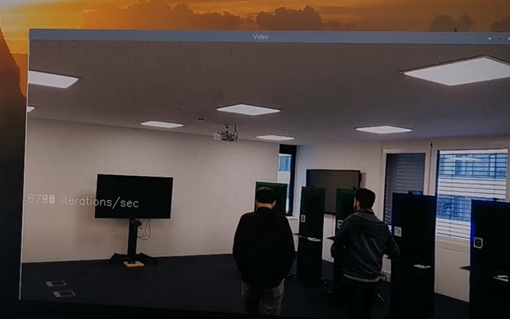
Autostart

Slide 5
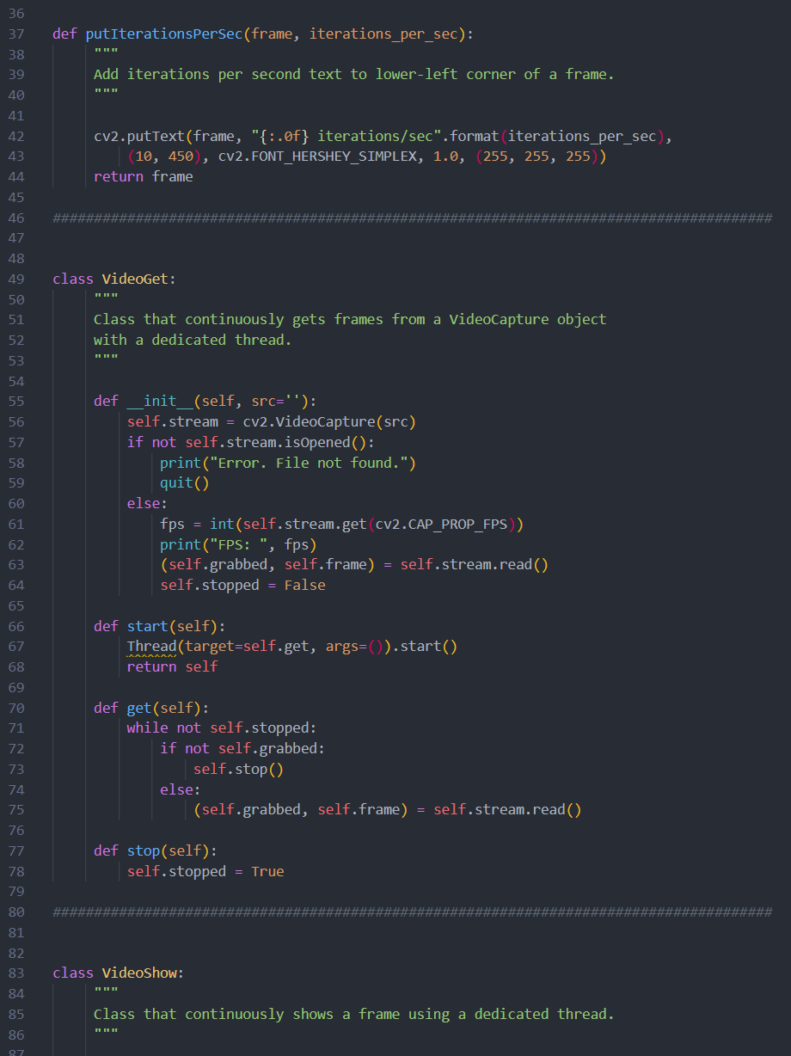
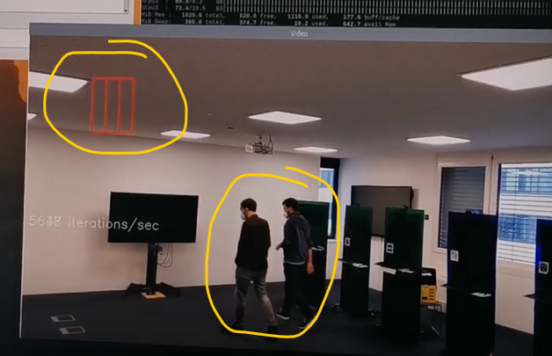
Logic (class based)
accepting speed for pi
problem: distorted person recognition drawing/detecting

Slide 6
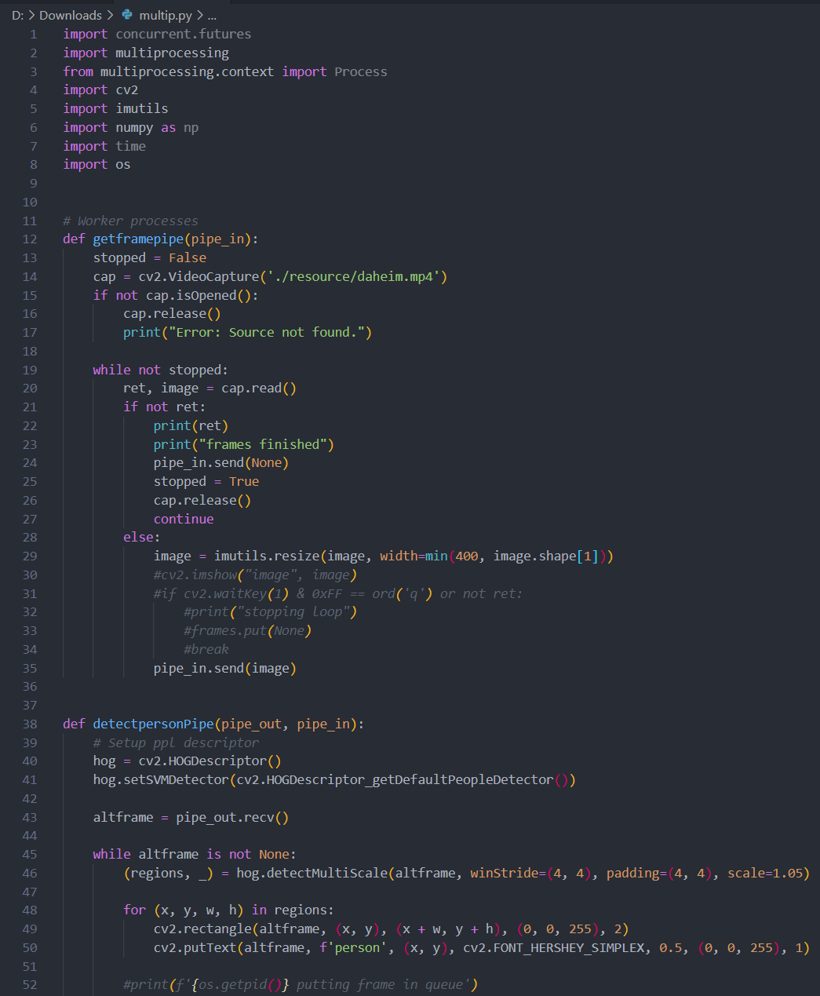
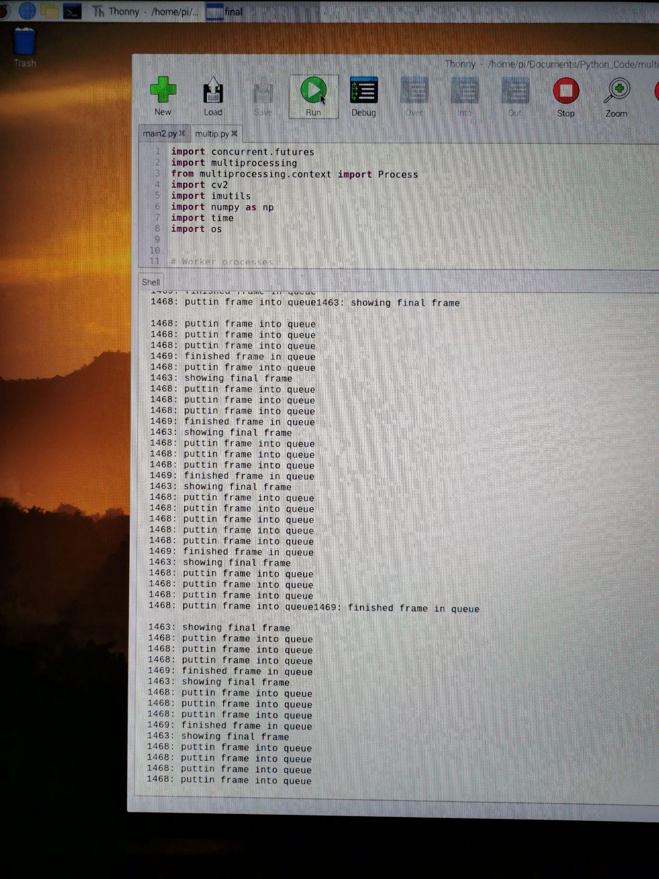
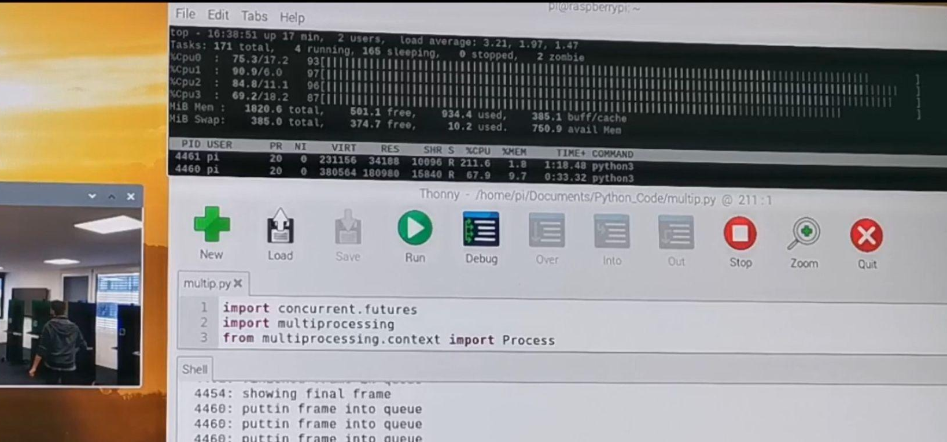
Logic (multiprocessing)
python multiprocessing module to utilize necessary speed
problem: low speed but full usage of all cores

Slide 7
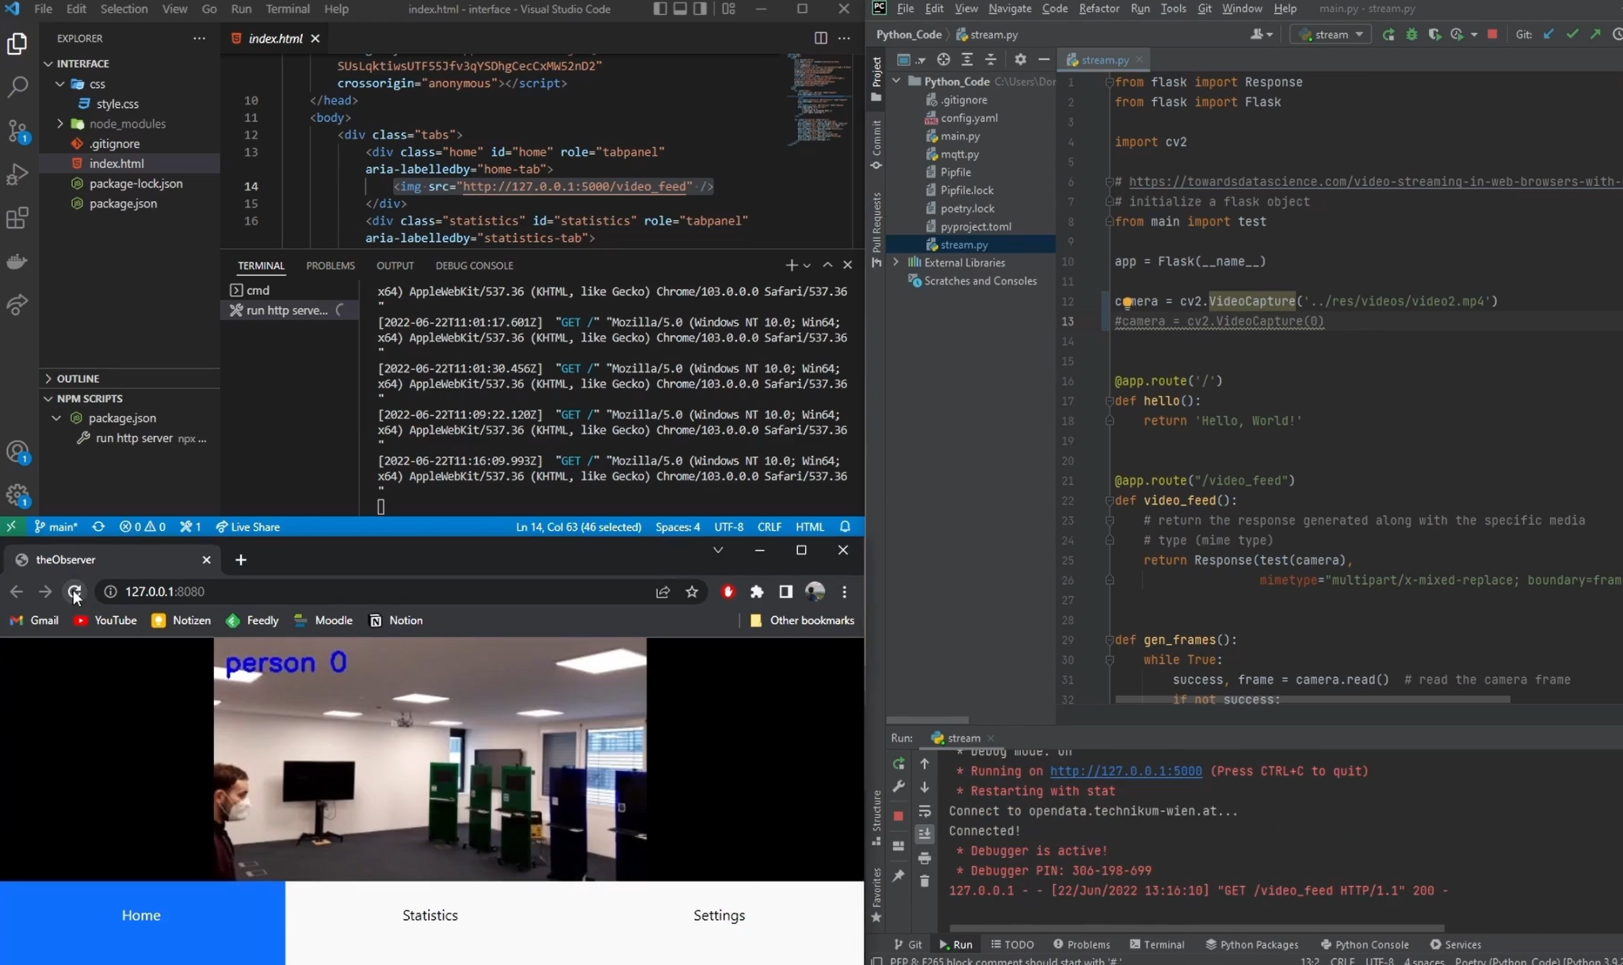
Interface
get picture via https
prepared for usage of statistics via influx & grafana environment

Slide 8
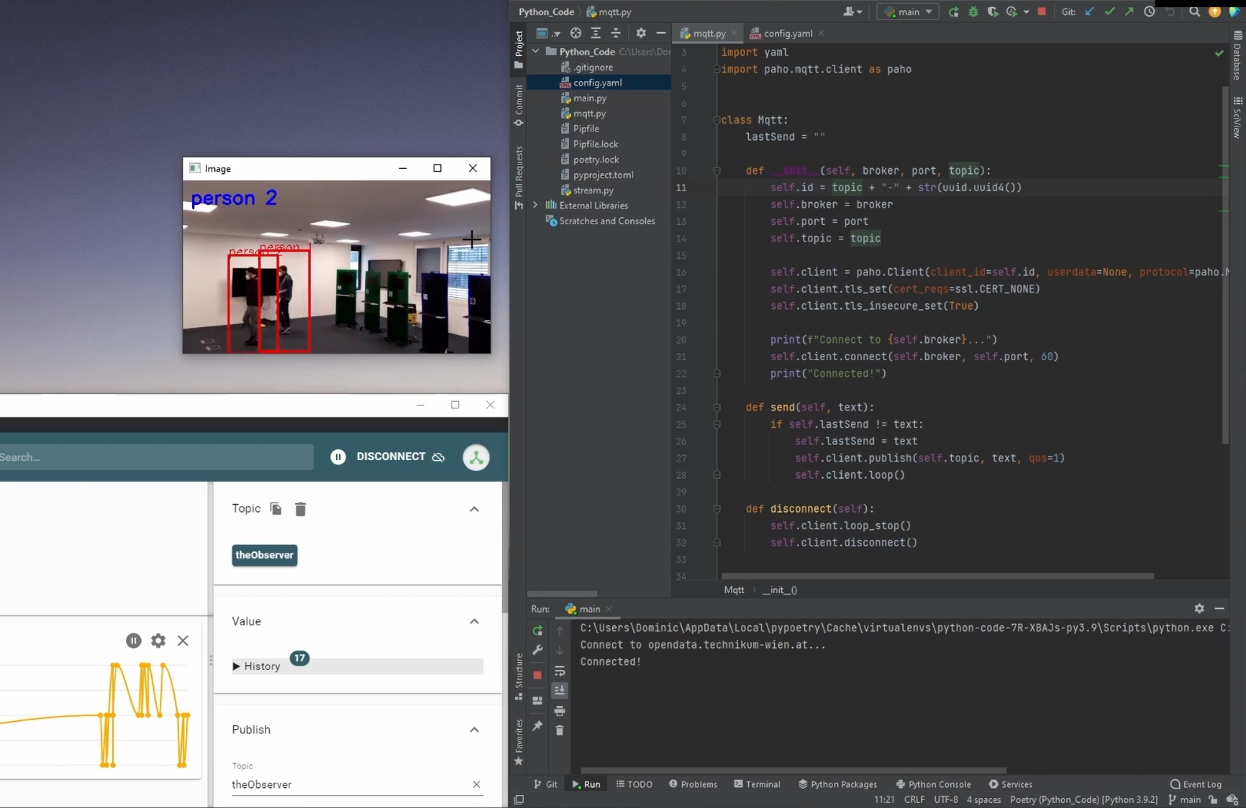
MQTT
record number of visitors
opendata.technikum-wien.at server used for the mqtt-broker
detected number of visitors is sent to the mqtt server and ready to be used (statistics)

Slide 9
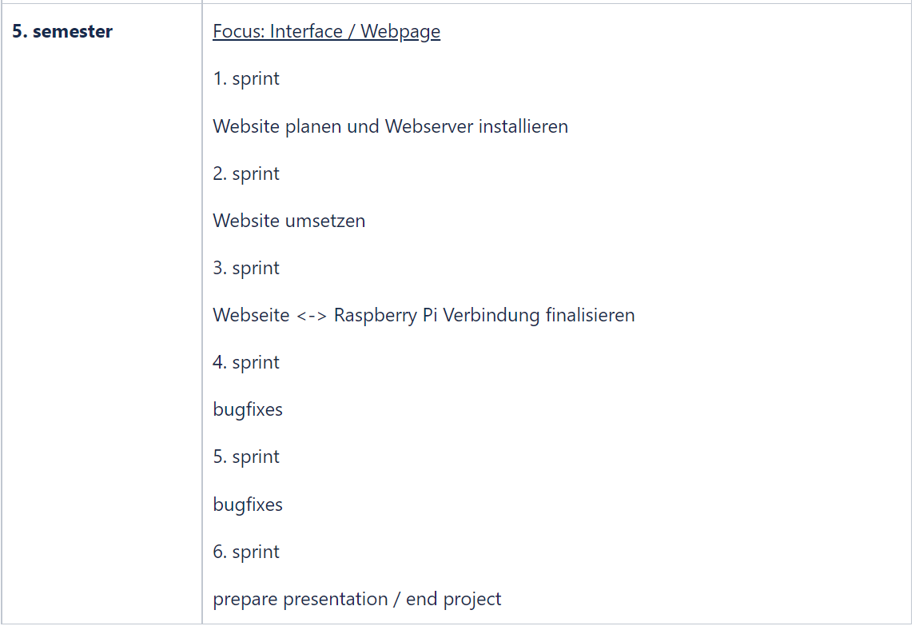
Open steps
bug fixes for person detection and multiprocessing
finalization interface
implementation webpage
3D print
final connection

Slide 10
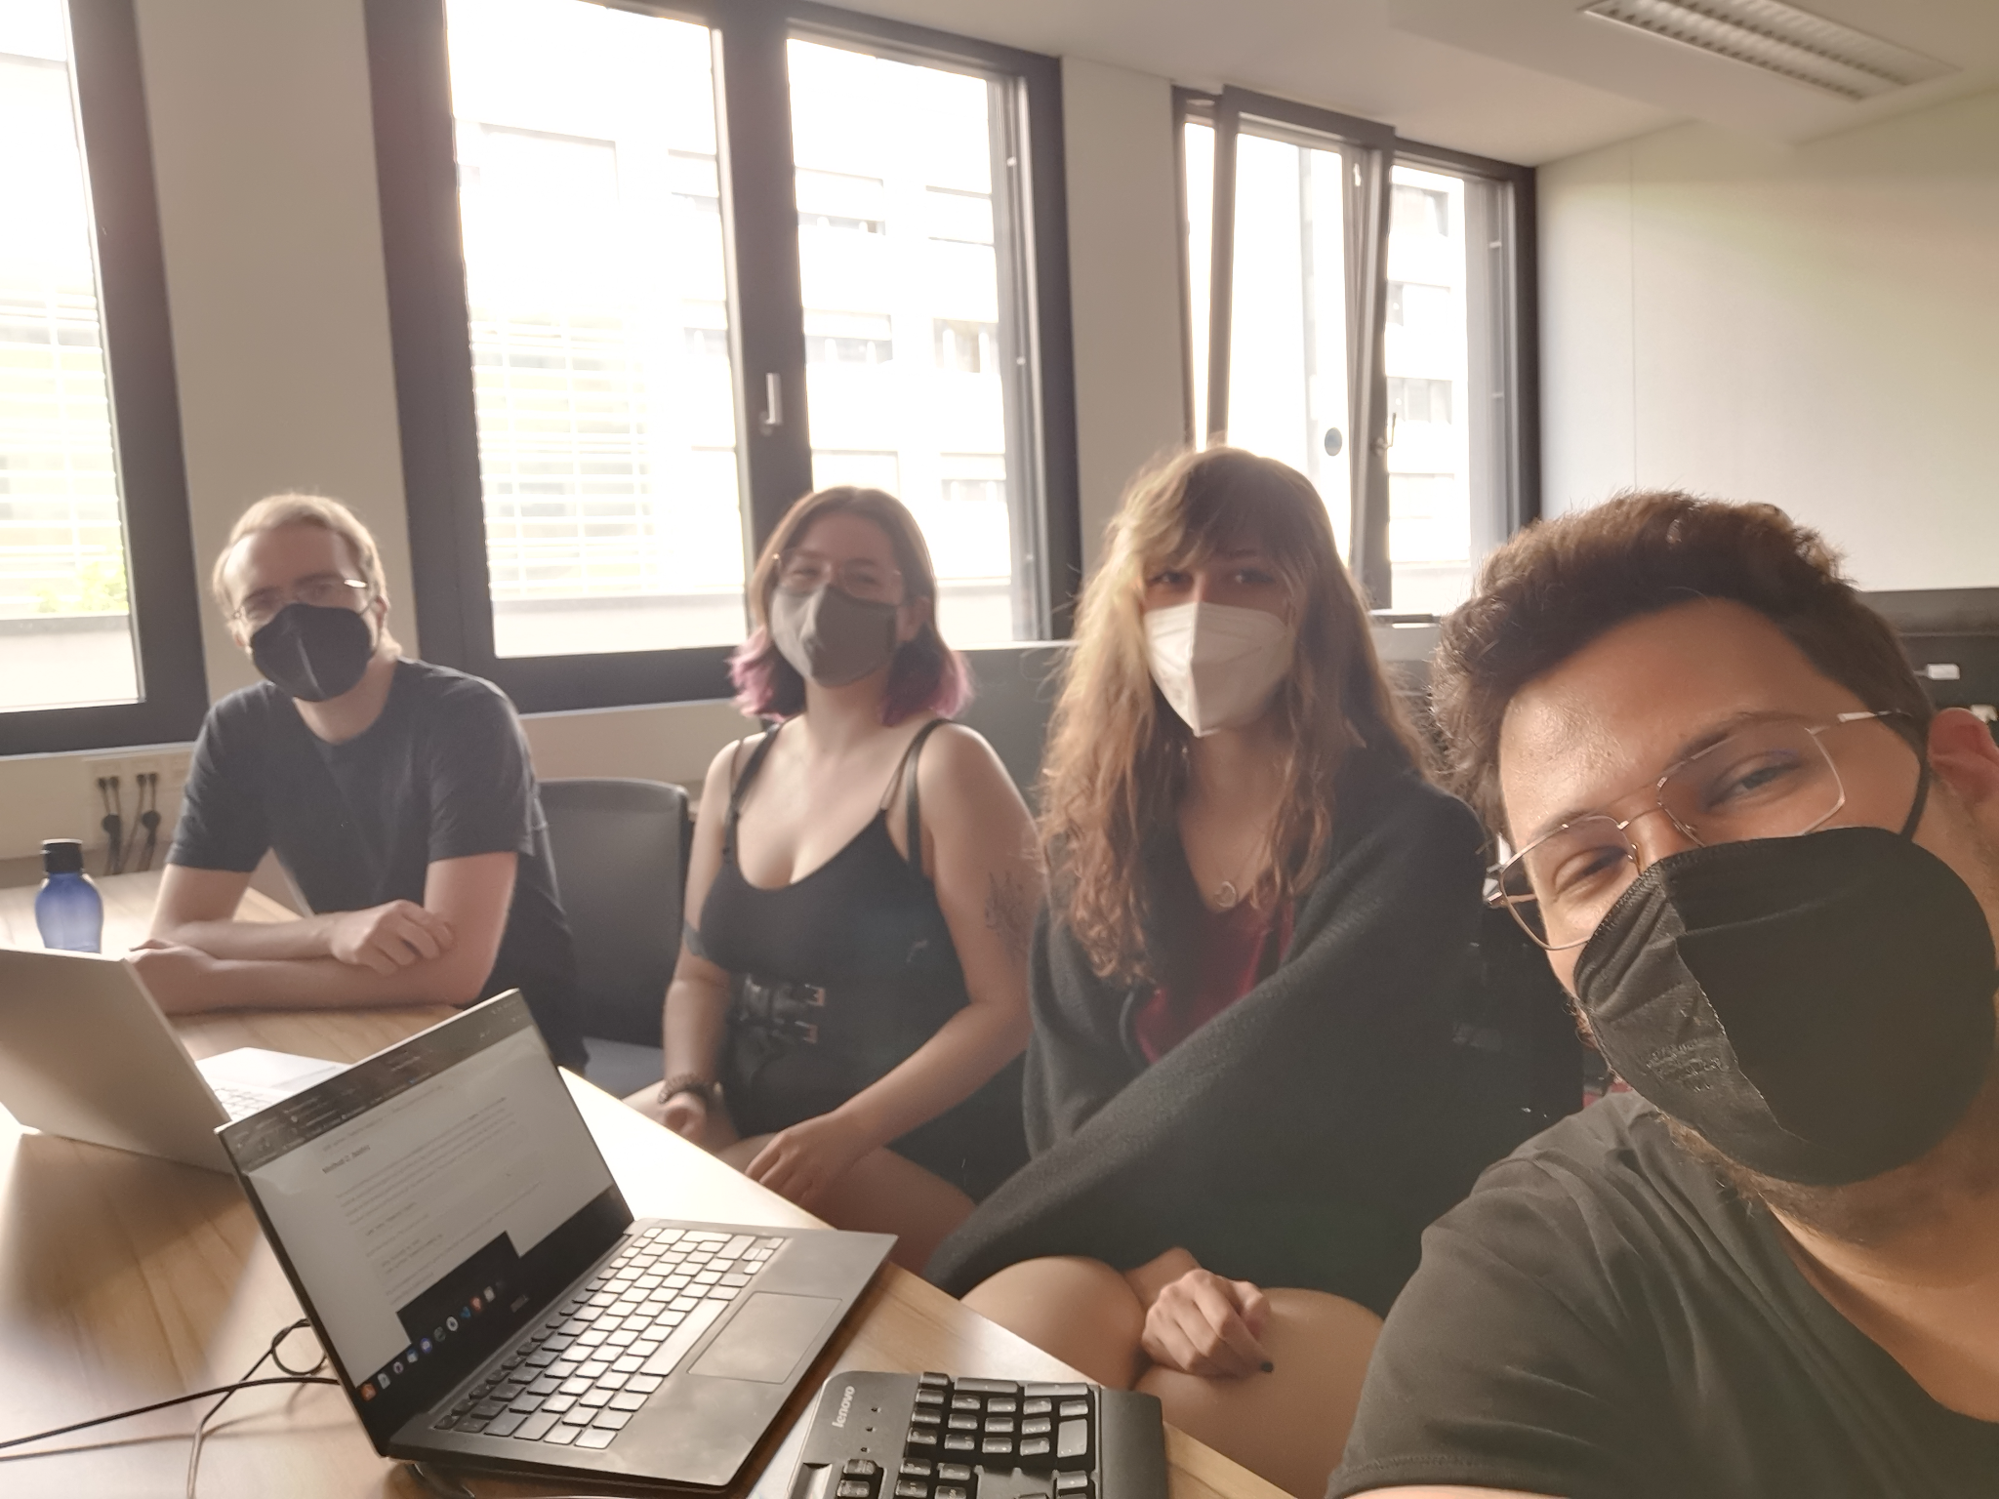
End of current phase
2 of 3 semesters done
start of upcoming phase #3 in late september 2022
same team, final product
Stefan Düx | Jessica Isabella Görög | Dominic Grabner | Rebekka Tscheppen | Lukas Varga
Visitor-Counter | Group 29 | BIF4 | Innovation Lab 2 | “the Observer”

